Slide 1
Eclipse Plug-in Development
Eclipse Plug-in Development Part 4
Preferences

Slide 2
Contents
Overview
Preference Store
Preference Pages
PreferencePage
FieldEditorPreferencePage
Preference Runtime
Scope
Initializer
Modify
Preference Dialog

Slide 3
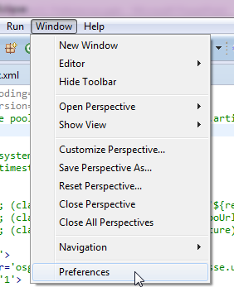
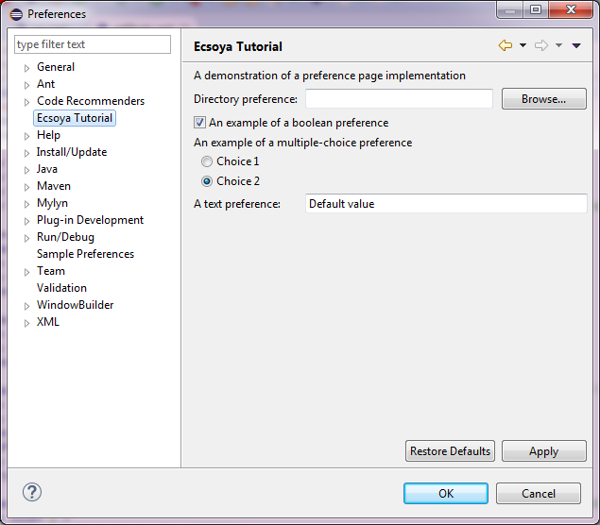
Overview

Slide 4
Preference Store
IPreferenceStore
Key: String
Value: Primitive Types
PreferenceConverter (org.eclipse.jface.preference)
RGB, FontData, Rectangle, Point
IPreferenceStore preferenceStore = Activator.getDefault().getPreferenceStore();
//Get value from store
boolean booleanValue = preferenceStore.getBoolean(PreferenceConstants.P_BOOLEAN);
//Set new value to store
preferenceStore.setValue(PreferenceConstants.P_BOOLEAN, false);

Slide 5
Preference Pages
org.eclipse.ui.preferencePages
id
name
class
category
<extension
point="org.eclipse.ui.preferencePages">
<page
name="Ecsoya Tutorial"
class="org.ecsoya.eclipse.tutorial.preference.preferences.SamplePreferencePage"
id="org.ecsoya.eclipse.tutorial.preference.preferences.SamplePreferencePage">
</page>
</extension>

Slide 6
Preference Pages
org.eclipse.ui.IWorkbenchPreferencePage
org.eclipse.jface.preference.PreferencePage
public class SamplePreferencePage2 extends PreferencePage implements IWorkbenchPreferencePage {
public SamplePreferencePage2() {
setPreferenceStore(Activator.getDefault().getPreferenceStore());
}
public void init(IWorkbench workbench) {
}
protected Control createContents(Composite parent) {
Label label = new Label(parent, SWT.NONE);
label.setText("Page 2");
return label;
}
}

Slide 7
Preference Pages
org.eclipse.ui.IWorkbenchPreferencePage
org.eclipse.jface.preference.FieldEditorPreferencePage
public class SamplePreferencePage extends FieldEditorPreferencePage implements IWorkbenchPreferencePage {
public SamplePreferencePage() {
super(GRID);
setPreferenceStore(Activator.getDefault().getPreferenceStore());
}
public void createFieldEditors() {
addField(new DirectoryFieldEditor(PreferenceConstants.P_PATH, "&Directory preference:", getFieldEditorParent()));
addField(new BooleanFieldEditor(PreferenceConstants.P_BOOLEAN, "&An example of a boolean preference", getFieldEditorParent()));
addField(new RadioGroupFieldEditor(PreferenceConstants.P_CHOICE, "An example of a multiple-choice preference", 1,
new String[][] { { "&Choice 1", "choice1" },
{ "C&hoice 2", "choice2" } }, getFieldEditorParent()));
addField(new StringFieldEditor(PreferenceConstants.P_STRING, "A &text preference:", getFieldEditorParent()));
}
public void init(IWorkbench workbench) {
}
}

Slide 8
Preference Pages
FieldEditors
BooleanFieldEditor
IntegerFieldEditor
StringFieldEditor
RadioGroupFieldEditor
ColorFieldEditor
FontFieldEditor
DirectoryFieldEditor
FileFieldEditor
PathEditor

Slide 9
Preference Runtime
org.eclipse.core.runtime.preferences
Scope – store and change
Eclipse preference scopes
Configuration scope – all workspace
Instance scope – single workspace
Default scope – default values
BundleDefaultsScope – preferences.ini
Project scope in org.eclipse.core.resource

Slide 10
Preference Runtime
org.eclipse.core.runtime.preferences
Initializer - AbstractPreferenceInitializer
public void initializeDefaultPreferences() {
IPreferenceStore store = Activator.getDefault().getPreferenceStore();
store.setDefault(PreferenceConstants.P_BOOLEAN, true);
store.setDefault(PreferenceConstants.P_CHOICE, "choice2");
store.setDefault(PreferenceConstants.P_STRING, "Default value");
}

Slide 11
Preference Runtime
org.eclipse.core.runtime.preferences
Modify - PreferenceModifyListener
public class PreferenceModifyListener1 extends PreferenceModifyListener {
public IEclipsePreferences preApply(IEclipsePreferences node) {
return super.preApply(node);
}
}

Slide 12
Preference Runtime
Reacting to changes in the preferences
IPropertyChangeListener
Activator.getDefault().getPreferenceStore()
.addPropertyChangeListener(new IPropertyChangeListener() {
public void propertyChange(PropertyChangeEvent event) {
if (PreferenceConstants.P_BOOLEAN.equals(event.getProperty())) {
System.out.println("Changed");
}
}
});

Slide 13
Preference Dialog
Filter and Open
PreferenceDialog dialog = PreferencesUtil.createPreferenceDialogOn(
shell,
//Show current page.
"org.ecsoya.eclipse.tutorial.preference.preferences.SamplePreferencePage",
//Filtered to show pages (null to show all)
new String[] {
"org.ecsoya.eclipse.tutorial.preference.preferences.SamplePreferencePage",
"org.ecsoya.eclipse.tutorial.preference.preferences.SamplePreferencePage2" },
null);

Slide 14
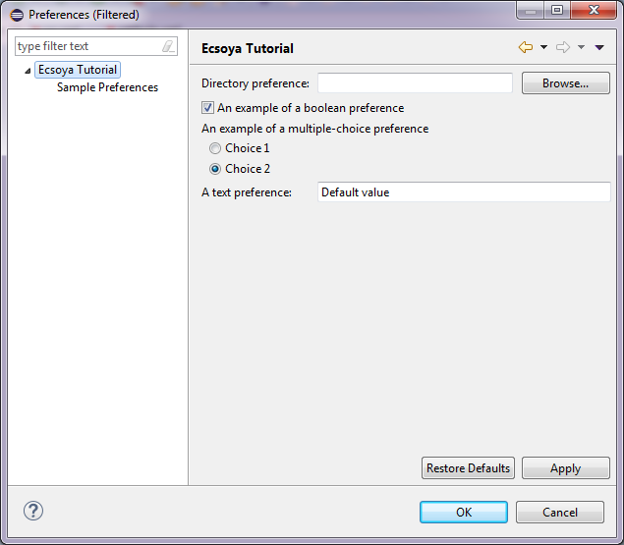
Preference Dialog

Slide 15
Any Questions?
Skype: jin.liu.soyatec
Email: jin.liu@soyatec.com

Slide 16
The end

